Slide 1



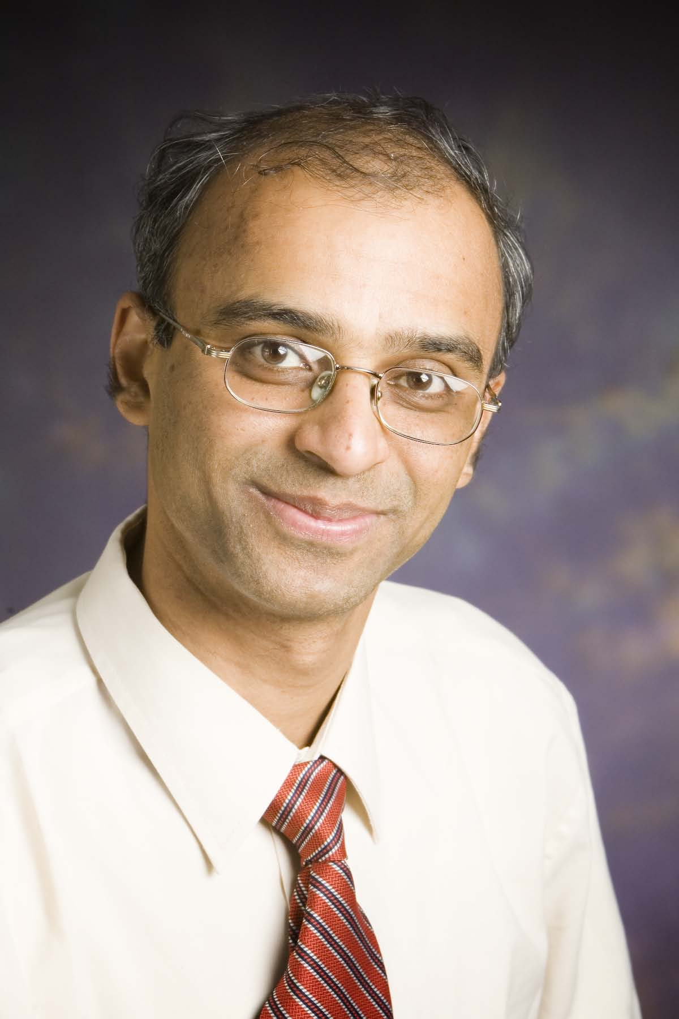
Operating Blockchains Near
Physical Limits
David Tse
EE 376a Guest Lecture
March 7, 2019
Vivek Bagaria
Stanford
Sreeram Kannan
U. Of Washington
Giulia Fanti
CMU
Pramod Viswanath
UIUC

Slide 2
Figure 1 of information theory
source
encoder
channel
decoder
What are the fundamental limits of performance?
How do we design good encoder/decoder to approach
the limits?

Slide 3
“Sapiens rule the world, because we are the only animal
that can cooperate flexibly in large numbers.”
- Harari, Sapiens
Cooperation requires trust.

Slide 4
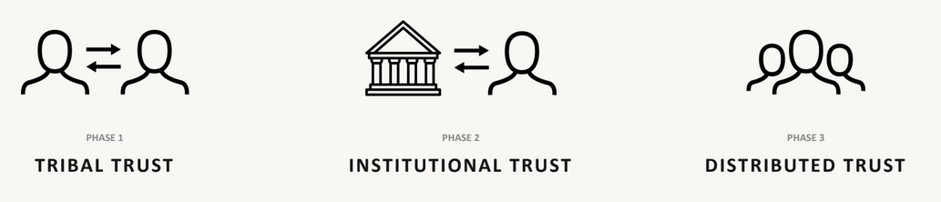
Evolution of Trust
large-scale
decentralized
permission-less

Slide 5
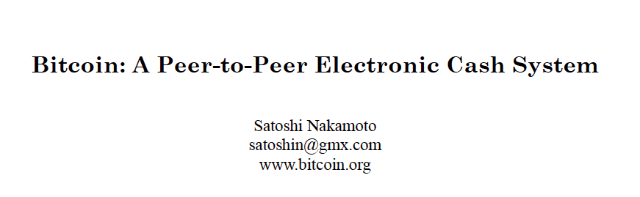
A breakthrough
Blockchain
Proof-of-work

Slide 6


Bitcoin performance
Confirmation
Latency
Security
Throughput
Bitcoin
50% adversary
5 transactions/s
13 kbits/s
hours

Slide 7


Physical Limits
=1 second
Network capacity C
Speed-of-light
propagation delay D
=20Mbits/𝑠

Slide 8
Operating near physical limits
Confirmation
Latency
Security
Throughput
Bitcoin
50% adversary
5 transactions/s
10’s kbits/s
hours
Prism
50% adversary
~ C
~ D

Slide 9




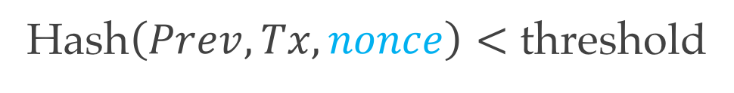
Ledger
Blockchain
000083207594
Hash of previous block Prev
083207594000
083207594000
000015473998
000097380089
Proof-of-work
Transactions Tx
000097380089
000098738900
000098738900
^89$%!0x0x1
000074984985
000074984985
000074984985
Hash$\left(Prev, Tx, nonce\right)<$ threshold
000074984985
?
24162534567
39478358989
02948734898
47895743895
000019234344
18739847932
000019234344
Mining new block
Notes:
The hash connects different blocks. Security

Slide 10
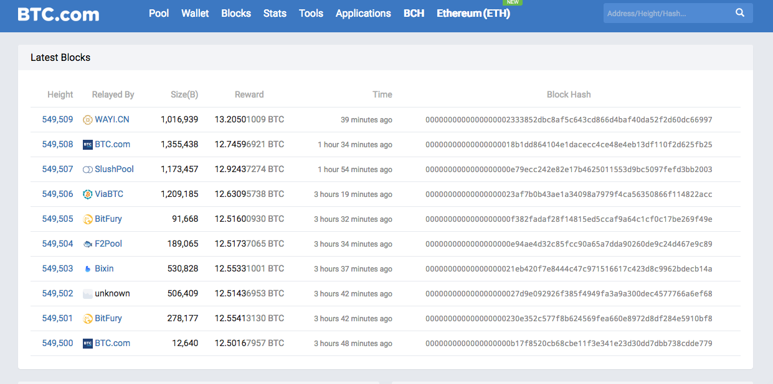

Slide 11



Distributed ledger
Public chain
Genesis
Poisson process
longest chain protocol

Slide 12




Private double-spend attack
Public chain
Genesis
Longest chain
Notes:
When can the adversary start mining? Before or after the transaction enters into the ledger.?
VB: Before. The goal is the mine on the parent of the block that includes the tx.

Slide 13

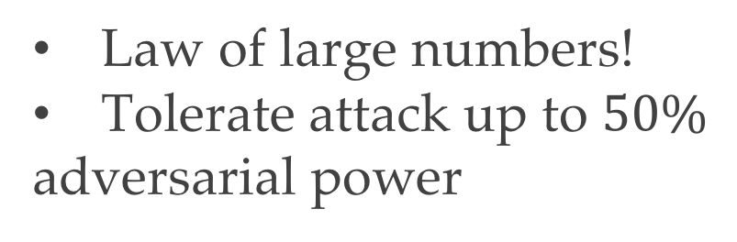
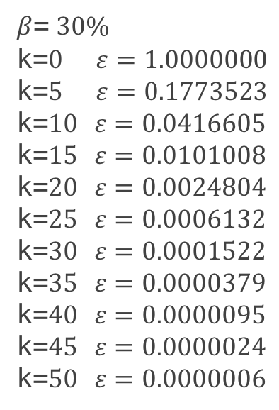
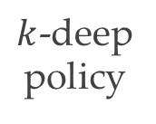
Defense: k-deep confirmation
Public chain
Genesis
Longest chain
$β$= $30\%$
k=$0$ $ε=1.0000000$
k=$5$ $ε=0.1773523$
k=$10$ $ε=0.0416605$
k=$15$ $ε=0.0101008$
k=$20$ $ε=0.0024804$
k=$25$ $ε=0.0006132$
k=$30$ $ε=0.0001522$
k=$35$ $ε=0.0000379$
k=$40$ $ε=0.0000095$
k=$45$ $ε=0.0000024$
k=$50$ $ε=0.0000006$
Adversarial power
$k$-deep
policy
Law of large numbers!
Tolerate attack up to $50\%$
adversarial power
Nakamoto’s table

Slide 14
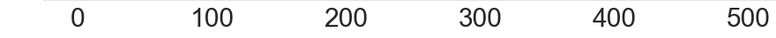
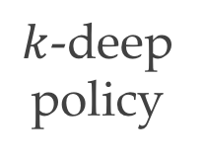
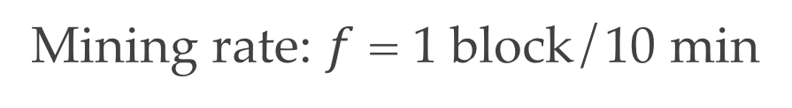






Latency and throughput
Public chain
Mining rate: $f$ = 1 block/10 min
Expected
time (mins)
Genesis
$$0$$
$ε$
(3 January 2009)
$$10$$
latency ~ 1/f
$$20$$
$k$-deep
policy
$$30$$
Latency (mins)
$$40$$
throughput ~ f
(Height 549509)
Right now
Notes:
The hash connects different blocks. Securit
Operational capacity --→ bandwidth consumption

Slide 15
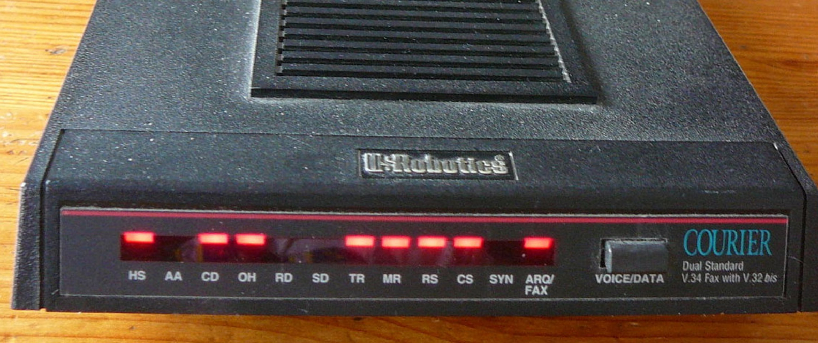
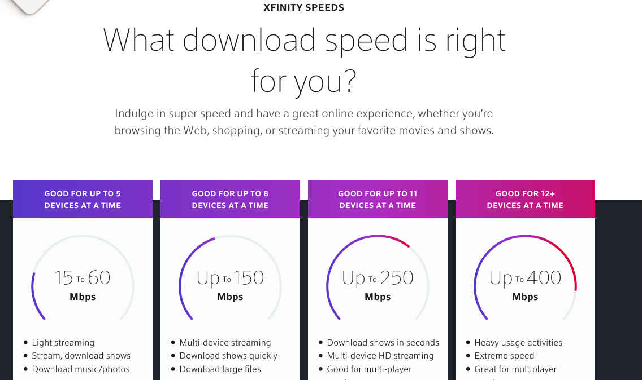
Physical limits
Bitcoin mining rate f = 1 block/ 10 min
Bitcoin bandwidth consumption ~ 13 kbits/seconds
1994
2018
1000 to 10,000 X
V.34 modem
C = 28.8 kbps
C = 10-100’s Mbps
increasing f 1000X?

Slide 16
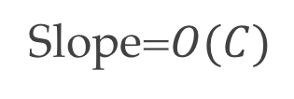
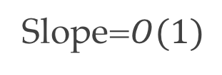
Latency and throughput
Public chain
Mining rate: $f$ = 1 block/10 min
Expected
time (mins)
Genesis
$$0$$
$ε$
(3 January 2009)
latency ~ 1/f
$$10$$
?
Slope=$O(C)$
$$20$$
$k$-deep
policy
Slope=$O(1)$
$$30$$
Latency (mins)
$$40$$
?
throughput = O(C)
(Height 549509)
Right now
Notes:
The hash connects different blocks. Securit
Operational capacity --→ bandwidth consumption

Slide 17
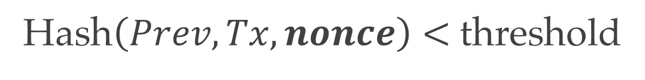
Increase mining rate f
Cryptographic puzzle:
Hash$\left(Prev, Tx, nonce\right)<$ threshold
increase threshold → easier puzzle → increase f

Slide 18

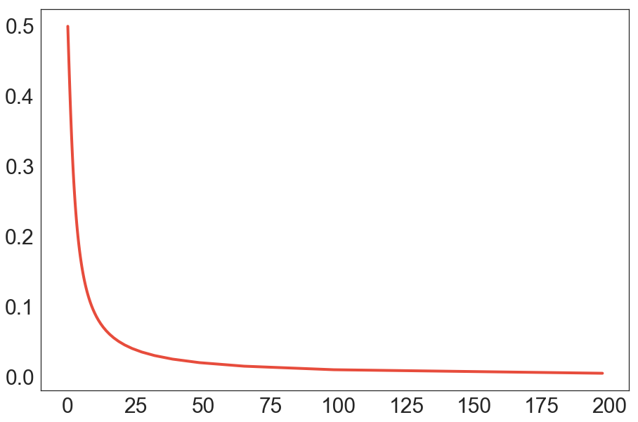

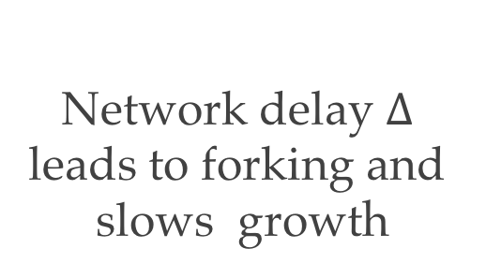
Forking
Change protocol?
GHOST, Inclusive, Spectre,
Phantom, Conflux ……….
1
2
3
4
1
Security
50%
2
5
6
7
8
9
40%
Longest chain
3
30%
Network delay $Δ$
leads to forking and
slows growth
20%
4
10%
0%
$$f$$
Natoli & Gramoli. The balance attack against proof-of-work blockchains: The r3 testbed as an example, 2016
Notes:
Before the forking, we can have an imaginary scenario where the chain grows very fast and shows the adversary can still not beat the honest nodes in the race. This allows the audience to compare and contrast.
After GHOST appsars, can you make the entire tree appear again? Then I can briefly talk about how GHOST works.

Slide 19

Two lessons learnt
Don’t mess with Nakamoto.
Need formal security analysis.
Garay, Kiayias & Leonardos. “The bitcoin backbone protocol: analysis and applications”, 2015
Notes:
To add PSS Citation

Slide 20
Deconstruct, then scale.

Slide 21
2 roles of a block
Bitcoin
Proposing
Proposing
Proposing
Voting
Voting
Voting
Notes:
Combine this and next slide.

Slide 22

Deconstruction
Bitcoin
Bitcoin Deconstructed
still secure
still poor latency
Proposers
Voters
Proposing
Proposing
Voting
Voting
Notes:
Combine this and next slide.

Slide 23
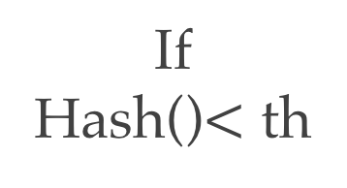
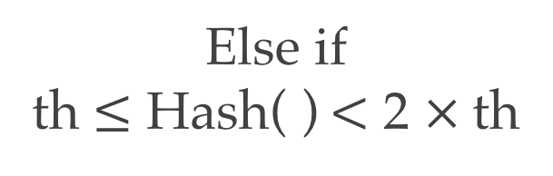
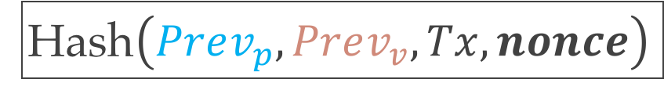
Prism: mining
Proposers
Voters
Block
Hash of previous proposer block
genesis
genesis
000005342122
Hash of previous voter block
000007594000
Transactions
Hash$\left(Prev_{p},Prev_{v}, Tx, nonce\right)$
If
Hash()$<$ th
Else if
th $≤$ Hash( )$<$ 2 $×$th
Sortition splits honest and
adversary work equally.

Slide 24
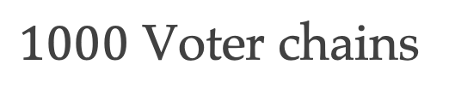
Prism
Law of large numbers again
Scaling Throughput
Proposers
$1000$ Voter chains
. . . . .
votes
fast
confirmation
. . . . .
optimal
throughput
. . . . .
Notes:
We now answer 1: we can now scale up the number of voter
Define leader sequence

Slide 25
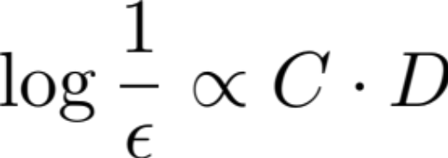
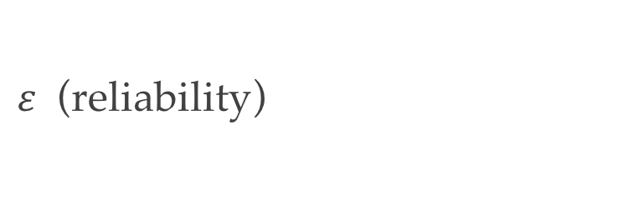
Prism: latency
$ε$ (reliability)
prism
Slope=$O(C)$
bitcoin
Slope=$O(1)$
latency (seconds)
Propagation delay D
bandwidth-delay product
Notes:
Go back to bitcoin latency-security plot
Now we have slope C
So stepp that network delay becomes relevant
Intersection of the vertical and linear gives a good operating point
Error probability exponentially small in exp(-CD), latency order d

Slide 26


Prism: formal guarantees
Theorem:
As long as the adversarial power is less than 50%, Prism is guaranteed
to :
achieves arbitrarily close to optimal throughput of
confirm honest transactions with delay proportional to D and
reliability exponentially small in the bandwidth-delay product CD.
3) create a totally ordered ledger of all transactions with persistency
and liveness properties.

Slide 27
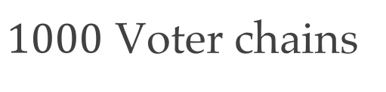
Public double-spends
Proposers
$1000$ Voter chains
499 votes
501 votes
. . . . .
Alice pays Bob
Alice pays Carol
Can we now confirm the block with 501 votes?
No.
But can now confirm that one of the two blocks is in the final ledger.
Eventually will be able to confirm which one.
Notes:
Adversary presents two proposer blocks and garner the same number of votes. System cannot accept either one because a small of votes may be reverted. However, over a long latency, all votes are secured and now a consensus can be obtained. Eventual total ordering of all transactions is always possible.
We need to name the cat for transaction :D

Slide 28
Figure 1 again
list of
transactions
encoder
channel
decoder
mining rule
mining randomness
+
adversary action
confirmation rule
Key performance metrics: throughput, latency, error probability
Key tools: joint encoder-decoder design, law of large numbers

Slide 29
Fundamental Limits: open questions
Can one fast confirm all transactions?
Can one be robust to adversarial power greater than 50%?

Slide 30
Deeper dive
Paper:
https://arxiv.org/abs/1810.08092
Video:
https://www.youtube.com/watch?v=WBTz_Gr0IUk

