Slide 1
EDUC 200C
Section 1– Describing Data
Melissa Kemmerle
September 28, 2012

Slide 2
First things…
Hi, I’m Melissa
  3rd year CTE student, math education
Goal of section this quarter
  Keep material as painless as possible
  Present some new material as necessary
  Review and answer questions about class concepts and problem sets
  Questions, comments, or concerns?

Slide 3
Today’s Goals
Discuss mean, variance, standard deviation
Look at Hands data
Introduce z-scores
Briefly introduce correlation
Answer any homework questions

Slide 4
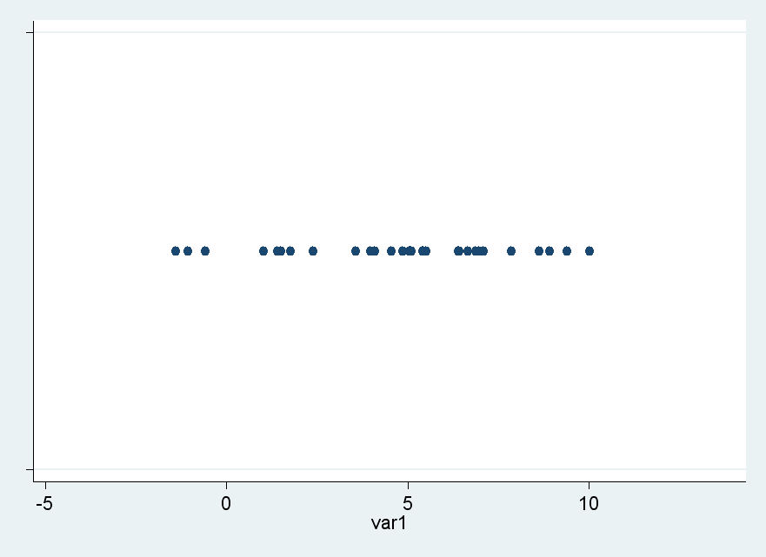
How do we describe data?
Measures of “central tendency” and measures of “spread”

Slide 5
Measures of Central Tendency
Mode, Median, Mean…

Slide 6
The mode
The mode is the score with the highest frequency of occurrences.
It is the easiest score to spot in a distribution.
It is the only way to express the central tendency of a nominal
level variable.

Slide 7
The median
The median is the middle-ranked score (50th percentile).
If there is an even number of scores, it is the arithmetic
average of the two middle scores.
The median is unchanged by outliers. Even if Bill Gates
were deleted from the U.S. economy, the median asset of
U.S. citizens would remain (more or less) the same.

Slide 8
The Mean
We’ll most commonly use the mean

Slide 9
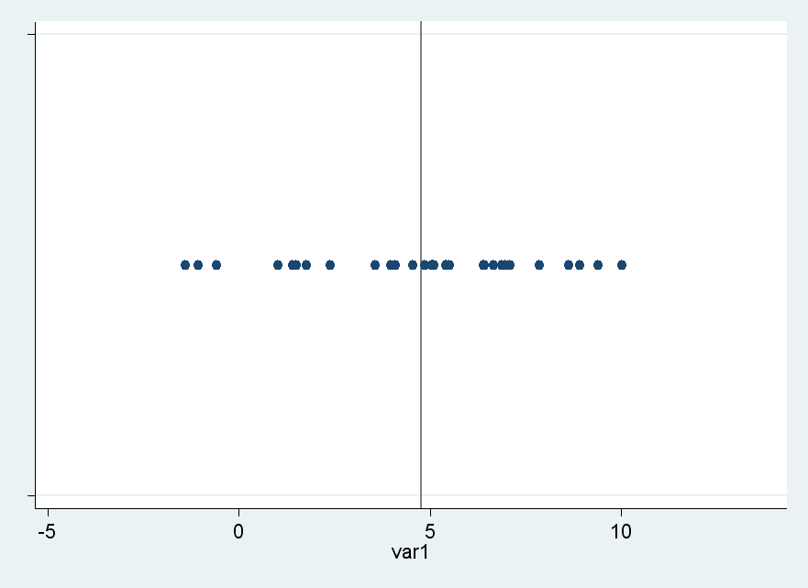
Visualizing the Mean

Slide 10
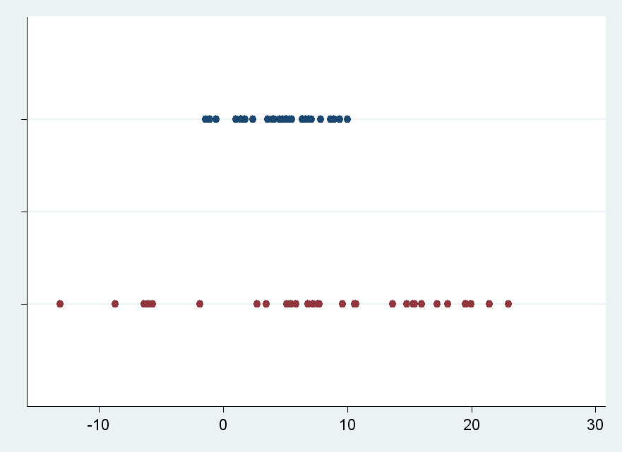
Measures of Spread
Variance, standard deviation
Why do we care about spread?

Slide 11

Deviation score
Measure the distance of each point from the mean

Slide 12
How do we summarize this?
Could use “mean deviation”
  But the sum of deviation scores will always be 0 (why?), thus mean deviation will always be 0
What about mean absolute value of the deviation?
  This will guarantee a positive sum of deviation scores, but has undesirable properties for more advanced statistics

Slide 13
Variance and Standard Deviation
The answer is to take the average of the squared deviation scores
This is called the variance
  Hard to interpret—still in “squared deviation” units
Standard deviation is the square root of the variance
  Gives a measure of deviation in the units of the original observations
  Note the N-1 is used to correct bias in estimates of sample standard deviation and variance

Slide 14
Calculating Mean and SD
It’s probably a good idea to do it by hand once or twice.
After that, you can use Excel.
Let’s look at our hands data.
Calculate mean and SD for each cohort’s hands data. Which cohort is best at estimating hand size? How can we tell?

Slide 15
Z-scores
We can transform data about different variables to the same scale by creating z-scores
This makes it easier to compare variables
Z-scores always have a mean of 0 and standard deviation of 1

Slide 16
Correlation
Correlation is used to describe how two variables vary with each other
What are some examples of variables that might have positive or negative or zero correlation?

Slide 17
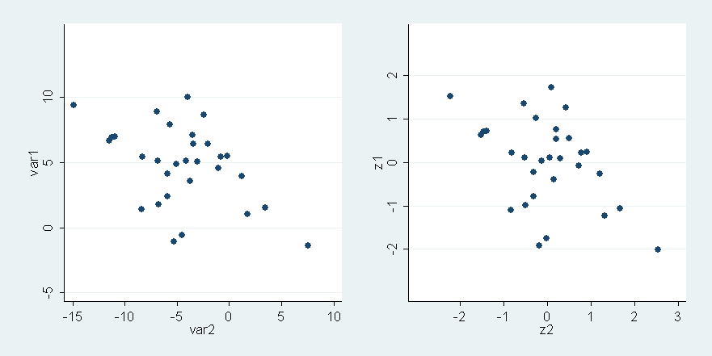
Z-scores don’t change correlation

Slide 18
Questions?

