Slide 1
Collaborations and Partnerships

Slide 2
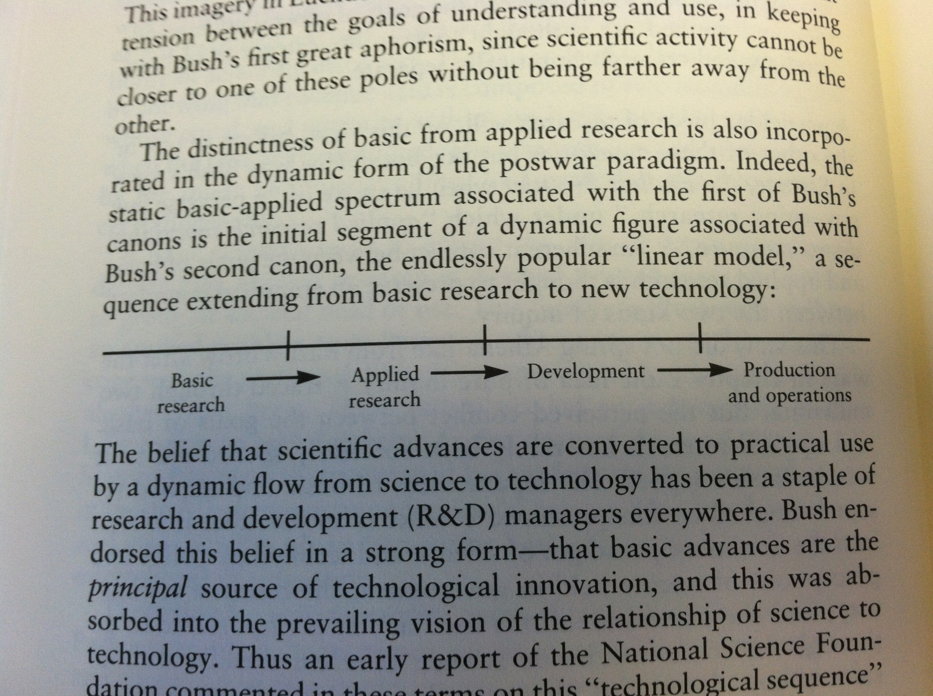
Vannevar Bush

Slide 3
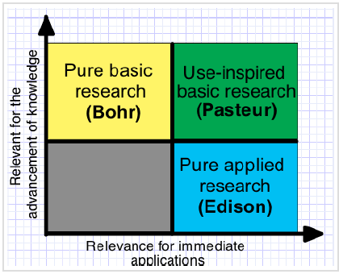
Pasteur’s Quadrant

Slide 4
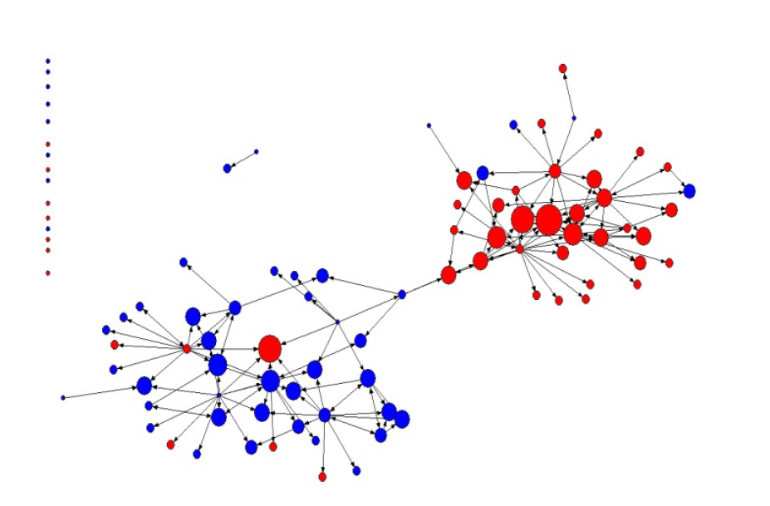

Slide 5
Week 7: Research Based Collaboration and Culture
Rosen looks at cross institutional collaboration in the attempt to scale up and implement educational interventions.
Rosen argues that the presence of of these supports is essential for successful alliances:
1. Relational Trust
2. Shared understandings of the work as well as the partner relationships
3. Mechanisms for consistent communication including individuals who can act as "boundary spanners."
4. Leadership to keep partnerships on track and ensure the effectiveness of these mechanisms
Rosen also addresses some needs specific to partnership between academic and commercial institutions. The first is the need for new institutional arrangements that address problems such as commercialization at the beginning rather than after they become problems. This also requires the development of shared mental models on commercialization, which is sometimes seen as undesirable in academic circles.
Reference: Rosen, L. Examining a Novel Partnership for Educational Innovation: Promises and Complexities of Cross-Institutional Collaboration. In C. Coburn & M. K. Stein (eds.) (2010). Research and Practice in Education: Building Alliances, Bridging Divide. Lanham, MD: Rowman & Littlefield.

Slide 6
“The Partnership for District Change: Challenges of Evidence Use in a Major Urban District” by Cynthia E. Coburn
Organizational & social conditions account for why access to research brokered by external partners is not used more in instructional decisions:
  District & other educational leaders differ in ideas around instruction because of preexisting views based on disciplinary background and training and/or focusing on different aspects/departments of education
  Opportunities must be available for individuals to develop shared understandings through social interaction and negotiation (based on social sense making research)
  Dialogue across education divisions and levels , rather than solely within divisions and levels, can lead to a more system-wide shared understanding of instructional approaches
  Resources (i.e. time, money, effort, access to research & focus) are necessary to sustain work over time & can lead to long-lasting, positive effects on instructional decision-making

Slide 7
Boston Public Schools
Purposeful Discussions held by leaders:
Thomas Payzant – Superintendent, proper support from the community
Barbara Neufeld – Founder of EdMatters, research firm
Ellen Guiney– Director: Boston Plan For Excellence
Common Framework for the “ambitious instructional practice” the district wished to see.
Both Neufeld and Guiney --- when both leaders found themselves frustrated, they would talk to each other, “there is a way in which that organization is her and this organization is me,” → Autonomous Decision Making
Not ever research findings was taken up and used by the central office leaders to the same degree.
The difference between high and low uptakes was the involvement of a strong and trusted intermediary organization—the Boston Plan for Excellence, whom facilitated the development of a shared knowledge base among the 3 partners (BPS, EdMatters, and The plan) and provided the capacity to interpret and act on research findings.

Slide 8
Factors Influencing Use of Research to Inform Practice
Conceptual beliefs and understandings
  Interpretations of research were filtered by pre-existing beliefs (e.g., district administrators tended to discount evidence that countered their existing beliefs about instruction) (Coburn 2010)
  More productive use of findings occurred when decision-makers shared frames for interpreting research (Hubbard 2010)
  Shared conceptual understandings of research facilitated development of shared solutions (Coburn 2010)
Availability of resources
  Adequate time, personnel, and external support are necessary for the effort, access, and focus required for deep engagement in research-driven deliberations (Coburn 2010)
  Tools that embed research- and practitioner-based concepts influenced practitioner thinking and actions when they were coupled with high quality assistance (Ikemoto and Honig 2010)
Social and organizational factors
  Relational trust and communication between district administrators and external partners was important in promoting productive, self-reinforcing relationship (but was vulnerable when concentrated among the district’s high-level management due to potential for leadership turnover) (Hubbard 2010)
  Cross-divisional and cross-level engagement at the district-level can contribute to shared understandings through negotiation while siloed units tend to foster varying views about instruction (Coburn 2010)

Slide 9
What is Research-Based School Organization?
Instrumental, Symbolic, Conceptual uses of research.

