Slide 1
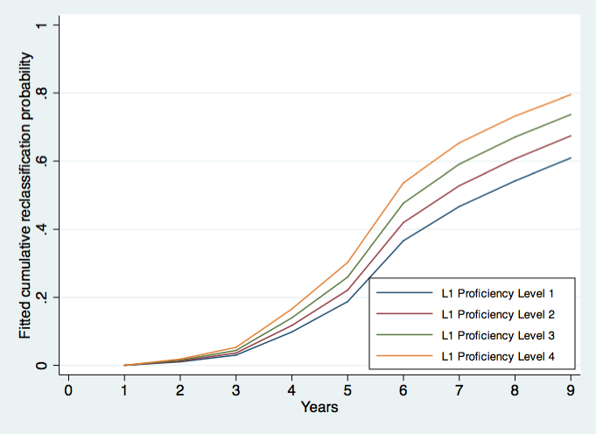

Slide 2
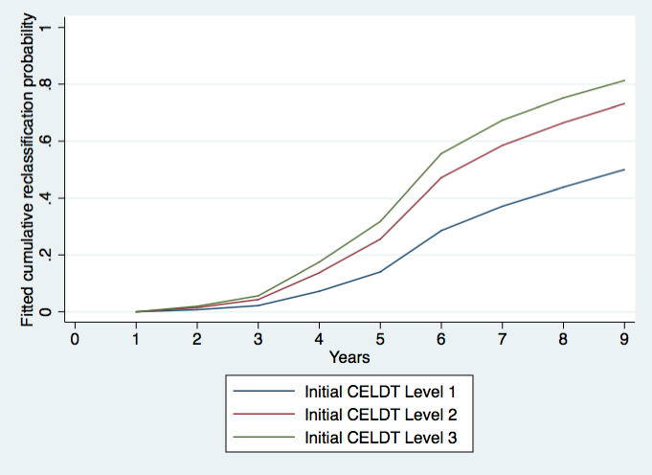

Slide 3
Alvaro
Recognizing the period from ages three to eighth for language development is necessary for providing the continuity and extended time for children to fully benefit these programs.
The Pk-3 years are critical years for developing mastery of sounds, structure, and functions of language, and thus are ideal time to expose children to the benefit of two languages.
  What is the role of the parents? How does this differ from adolescent English language learners?

Slide 4
Week 10: Early Childhood Programs
Espinosa addresses the needs of English Learners by focusing on their development in k-3 especially. She presents 6 Myths which must be dispelled. She argues that understanding and using the research findings, which sometimes runs contrary to common sense, is essential to adequately educating EL students. The six myths are;
1. Learning two languages during the early childhood years will overwhelm, confuse, and/or delay a child’s acquisition of English.
2. Total English immersion from Prekindergarten through Third Grade is the best way for a young English Language Learner to acquire English.
3. Because schools don't have the capacity to provide instruction in all of the languages represented by the children, they should provide English-only instruction.
4. Native English speakers will experience academic and language delays if they are enrolled in dual language programs.
5. Spanish-speaking Latinos show social as well as academic delays when entering Kindergarten.
6. Latino English language learners are less likely to be enrolled in Prekindergarten programs, because of their families’ cultural values.
Understanding these myths and the findings in the research on this topic emphasizes the importance of developing quality early childhood education designed to serve all children of varying linguistic backgrounds and prepare them for academic success.
Reference: Espinosa, Linda (2008). Challenging Common Myths about Young English Language Learners. Foundation for Child Development.

Slide 5
Challenging Common Myths About Young ELLs (ages 3 - 8)
Young ELLs are quite capable of learning content in 2 languages ; bilingual infants develop 2 separate, but connected linguistic systems in 1st year of life
Bilinguals may even benefit cognitively from learning more than one language; greater brain tissue density in areas related to language, memory, & attention
Transitioning from 1st language to English before having developed well 1st language, usually by end of 3rd grade, may be harmful in the long run
ELLs in English-only classrooms or who received English instruction before developing oral language well in their 1st language often never achieve high levels of English fluency; ELLs who learn in two languages outperformed ELLs who learned in English-only instruction
Factors that influence English mastery of young ELLs:
  Language spoken at home
  Socioeconomic family circumstances
  Age of child & exposure to English
  Fluency in home language
  Circumstances surrounding family’s US immigration
  Popular family values & customs
Because of the numerous factors mentioned above, no one ELL model will benefit all students and contexts. Rather, programs must adapt to needs of ELLs and be in accordance with the expertise of a school’s staff, resources & capacity, & community priorities.
Intensive support for home language during ages 3 – 8 (i.e. talk with, read to, sing to child, use home language in everyday activities) will help, not hurt, English language development

Slide 6
Supporting English Learners in Early Childhood Programs
Instructional Strategies: Instruction should feature adaptations for ELs that reflect an understanding of the stages of second language development (i.e., use of L1 to communicate→ period of observation and listening → “going public” with telegraphic and formulaic communication in L2→ fluid/productive use of L2); employ appropriate methods for scaffolding communication; embed both content learning and English language development; build skills across all language domains (listening, speaking, reading, and writing); and accommodate ELs’ individual differences and needs.
Role of Home Language: Use of L1 can promote English language learning through transfer and development of meta-linguistic skills, help ELs make connections between the language they know and the language they are learning, promote acceptance and valuing of ELs’ home language, grant ELs immediate access to the curriculum, and provide opportunities for native English-speakers to learn words in other languages
Influence of Cultural Values and Norms: Educators should be aware that different language groups employ different social conventions for language use (e.g., orientation toward role of adults and children as conversational partners, expectations for initiating conversations, amount of talk considered appropriate, when and how to ask questions) as well as different narrative structures for discourse (e.g., emphasis placed on communication of information, social engagement, family interaction, etc); classroom environment and materials should reflect ELs’ family culture, customs, and language

Slide 7
California Preschool Learning Foundations
California Department of Education indentifies three important early learning foundations that should be addressed in Preschools:
Social-Emotional Development
Language and Literacy English-Language Development
Mathematics
-Within the English language development domain CDE indentifies four major strands that can be addressed at the pre-school level
Listening, which includes understanding words, requests and directions, and basic and advanced concepts
Speaking, which focuses on using English to communicate needs, expand vocabulary, become skillful at engaging in conversations, use increasingly complex grammatical constructions when speaking, understand grammar, ask questions, use social conventions, and tell personal stories
Reading, which covers appreciating and enjoying reading, understanding book reading, understanding print conventions, demonstrating awareness that print conveys meaning, developing awareness and recognition of letters, demonstrating phonological awareness, and manipulating sounds, such as rhyming
Writing, which includes understanding the communicative function of writing and engaging in simple writing and writing-like behaviors

Slide 8
Challenging Common Myths About Young English Language Learners (Espinosa 2008)
The policy brief helps dispel some of popularly held “myths” or unverified ideas about PK-3 ELL such as home language being a hindrance for English proficiency, English-only immersion program is a better choice than dual language immersion program, and so on.
The brief seem to highlight two particular points:
  Early childhood is optimal time for ELL to learn English as a language as well as learning for academic content
  There are a few misconceptions particularly surrounding the Spanish-language speaking ELL. This implies that other racial or ethnic groups ELLs may have separate stereotypes or misconceptions
For district or school leaders, this policy brief may be instrumental if they could have clear guidelines on how to support students’ first language learning in classroom settings. At the same time, if there is a longitudinal study on how much influence early childhood’s first language learning supports children’s English language learning, it would be even more convincing.

