Slide 1
Education 330
Teaching English Language Learners:
Issues in Policy, Leadership, and Instruction
Spring, 2012

Slide 2

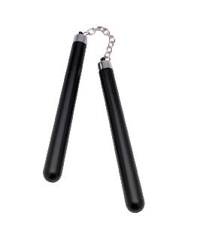


Policy and Practice:
Carrots and Sticks
Civil Rights Act, Lau v. Nichols, EEOA, Castañeda interpretation.
Elementary and Secondary Education Act Title I, Title III…
Notes:
2

Slide 3
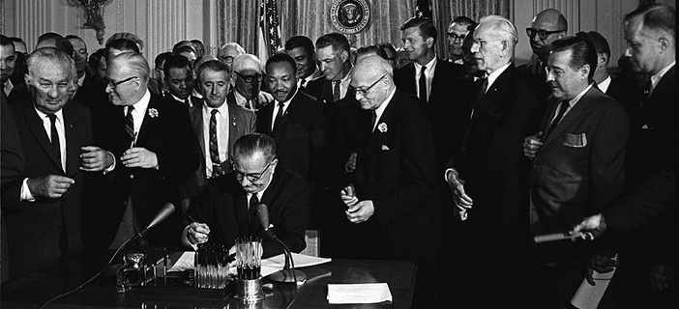
Civil Rights Act of 1964

Slide 4

Lau v. Nichols (1974)
Source: Historical Photograph Collection of San Francisco Public Library's San Francisco History Center.

Slide 5
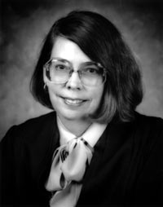
Castañeda v. Pickard (1981)
Fifth Circuit Court of Appeals
§ 1703(f) of the EEOA makes it unlawful for an educational agency to fail to take "appropriate action” to overcome language barriers that impede equal participation by its students in its instructional programs."
(1) Whether the school system is pursuing a program informed by an educational theory recognized as sound by some experts in the field, or, at least, deemed a legitimate experimental strategy.
(2) Whether the programs and practices actually used by the school system are reasonably calculated to implement effectively the educational theory adopted by the school.
(3) Whether the school's program succeeds, after a legitimate trial, to produce results indicating that the language barriers confronting students are actually being overcome.
Judge Carolyn Randall (King)
648 F.2d 989; 1981 U.S.
Notes:
5

Slide 6
Castañeda v. Pickard (1981)
Fifth Circuit Court of Appeals
§ 1703(f) of the EEOA makes it unlawful for an educational agency to fail to take "appropriate action” to overcome language barriers that impede equal participation by its students in its instructional programs."
(1) Whether the school system is pursuing a program informed by an educational theory recognized as sound by some experts in the field, or, at least, deemed a legitimate experimental strategy.
(2) Whether the programs and practices actually used by the school system are reasonably calculated to implement effectively the educational theory adopted by the school.
(3) Whether the school's program succeeds, after a legitimate trial, to produce results indicating that the language barriers confronting students are actually being overcome.
648 F.2d 989; 1981 U.S.
Notes:
6

Slide 7
Castañeda v. Pickard (1981)
Fifth Circuit Court of Appeals
§ 1703(f) of the EEOA makes it unlawful for an educational agency to fail to take "appropriate action” to overcome language barriers that impede equal participation by its students in its instructional programs."
(1) Whether the school system is pursuing a program informed by an educational theory recognized as sound by some experts in the field, or, at least, deemed a legitimate experimental strategy.
(2) Whether the programs and practices actually used by the school system are reasonably calculated to implement effectively the educational theory adopted by the school.
(3) Whether the school's program succeeds, after a legitimate trial, to produce results indicating that the language barriers confronting students are actually being overcome.
648 F.2d 989; 1981 U.S.
Notes:
7

Slide 8
Castañeda v. Pickard (1981)
Fifth Circuit Court of Appeals
§ 1703(f) of the EEOA makes it unlawful for an educational agency to fail to take "appropriate action” to overcome language barriers that impede equal participation by its students in its instructional programs."
(1) Whether the school system is pursuing a program informed by an educational theory recognized as sound by some experts in the field, or, at least, deemed a legitimate experimental strategy.
(2) Whether the programs and practices actually used by the school system are reasonably calculated to implement effectively the educational theory adopted by the school.
(3) Whether the school's program succeeds, after a legitimate trial, to produce results indicating that the language barriers confronting students are actually being overcome.
648 F.2d 989; 1981 U.S.
Notes:
8

Slide 9
Sound theory
revise
examine
Results
reform
Implementation
evaluate
Articulated in OCR policy memoranda issued on Sept. 11, 1984, reiterated successively in 1985, 1990, 1991.
Notes:
This is not rocket science, but give us a framework as we think about what is a good district or school practice.
It is important to note that this framework needs to apply to both the English language acquisition needs of the students, and to the academic content needs of the students. Both are clearly articulated in Lau, as well as most recently in NCLB.
9

Slide 10
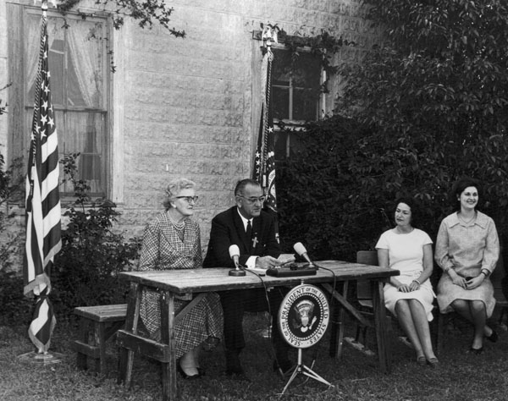
Elementary and Secondary Education Act
ESEA (1965)

Slide 11
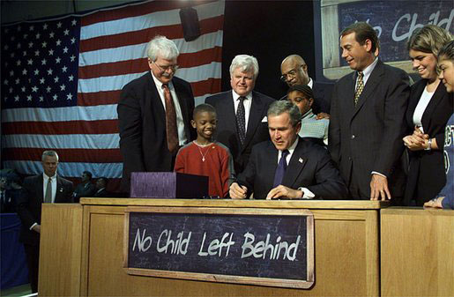
No Child Left Behind

Slide 12

No Child Left Behind:
Three important pieces for ELLs
Sec. 1111(a)(3)(ix)(III) the inclusion of limited English proficient students, who shall be assessed in a valid and reliable manner and provided reasonable accommodations on assessments administered … including, to the extent practicable, assessments in the language and form most likely to yield accurate data…
Sec. 1111(a)(3)(xiii) enable results to be disaggregated within each State, local educational agency, and school by…English proficiency status.
Sec 3113(b)(2) standards and objectives for raising the level of English proficiency that are derived from the four recognized domains of speaking, listening, reading, and writing, and that are aligned with achievement of the challenging State academic content and student academic achievement standards described in section 1111(b)(1).

