Slide 1
Monday, April 9
What can we say about the number of ELLs in the United States?
What can we say about the academic achievement of ELLs?
What role has ESEA played in addressing the academic needs of ELLs?
Do we think that ESEA has been effective, and how can it be improved?

Slide 2
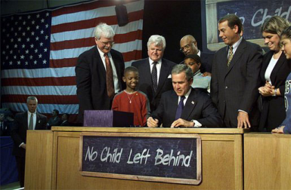
No Child Left Behind:
Three important pieces for ELLs
Sec. 1111(a)(3)(ix)(III) the inclusion of limited English proficient students, who shall be assessed in a valid and reliable manner and provided reasonable accommodations on assessments administered … including, to the extent practicable, assessments in the language and form most likely to yield accurate data…
Sec. 1111(a)(3)(xiii) enable results to be disaggregated within each State, local educational agency, and school by…English proficiency status.
Sec 3113(b)(2) standards and objectives for raising the level of English proficiency that are derived from the four recognized domains of speaking, listening, reading, and writing, and that are aligned with achievement of the challenging State academic content and student academic achievement standards described in section 1111(b)(1).

Slide 3
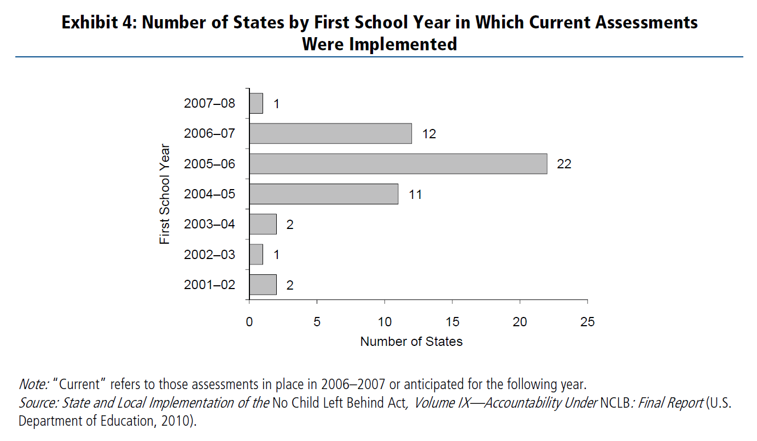
NCLB Implementation
Ramsey, A. & O’Day, J. (2010). Title III Policy: State of the States. ESEA Evaluation Brief: The English Language Acquisition Act, Language Enhancement, and Academic Achievement Act. Washington, DC: American Institutes for Research.

Slide 4
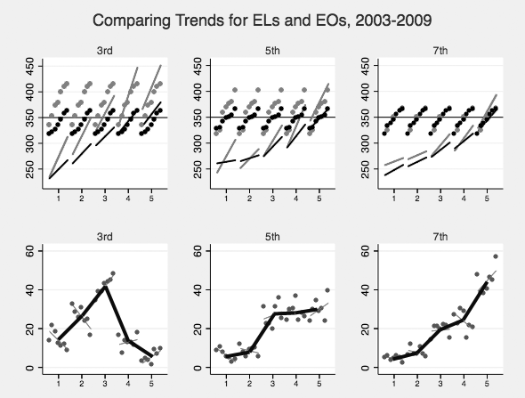

Slide 5
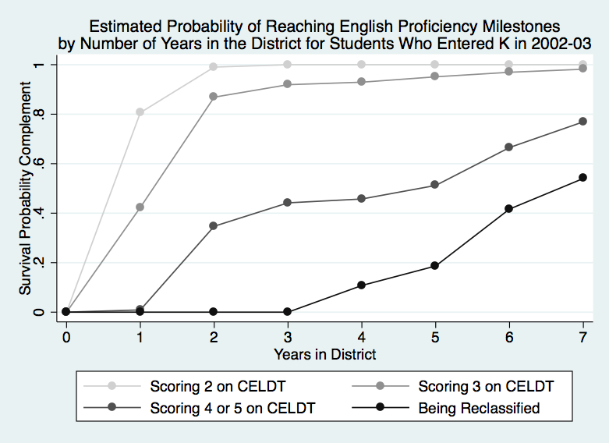

Slide 6
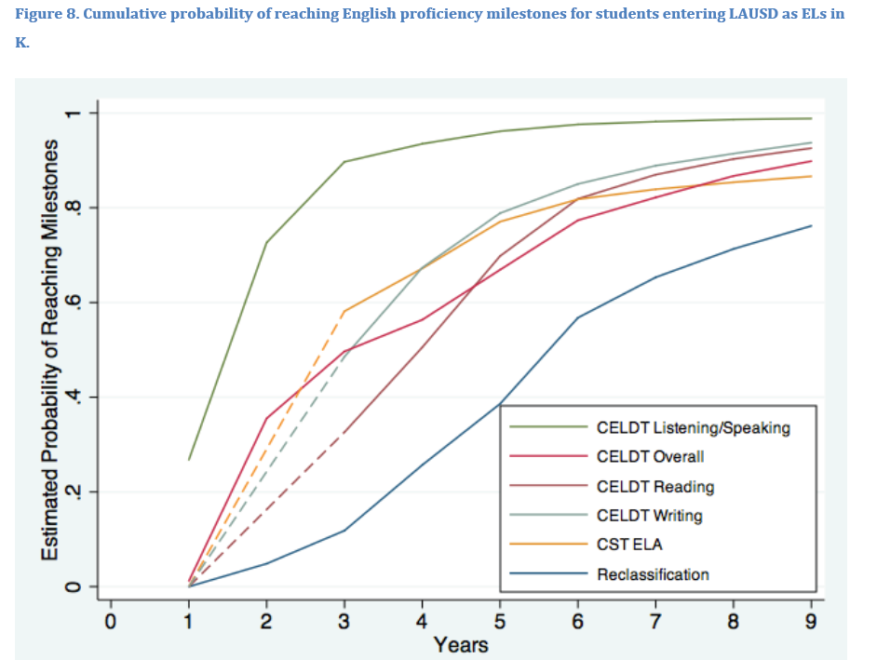

Slide 7

The Revolving Door Problem

Slide 8
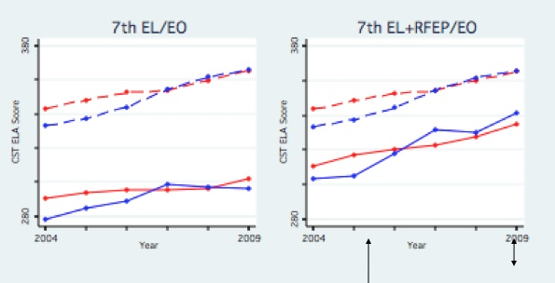
)
Hakuta & Thompson, 2009
Notes:
Kenji
Now, here is what you get if you exclude the former ELLs. The gap increases, and in fact, by 7th grade, the Sanger data shows that is is doing worse than the state as a whole. This is because Sanger is successful in reclassifying its ELLs, and therefore a larger proportion of their students are no longer in the ELL category. Rather than being rewarded for this, their data make them look worse than the state overall.
So, fixing this revolving door problem, while continuing to pay attention to the needs of the low-performing ELLs, is one focus of our recommendations.
Fixing the revolving door addresses concerns not just about the low-performing ELLs but also former ELLs:
For example, current law (regs) calls for subgroup accountability for graduation rates based on tracking cohorts of high school students and accounting for the outcome of each using individual student identifiers. A four year or extended year cohort measure will see too much turnover to reliably calculate graduation rates, but that problem is solved if schools are held accountable after proficiency is attained.
Also, concerns about inappropriate reclassification of ELLs before they become English proficient, are addressed by keeping all ELLs in the group.
Finally ...less important, but maybe worth mentioning is that problematic "n" size issues will be greatly diminished...so many schools and districts that serve fewer than 100 ELLS at a time would be held accountable for the more stable ELL group.

