Slide 1




Carrots and Sticks
Is the system working?
Civil Rights Act, Lau v. Nichols, EEOA, Castañeda interpretation.
Elementary and Secondary Education Act Title I, Title III…
Notes:
1

Slide 2
Title III Policy: State of the States
10% (roughly 4.7 million) of K-12 public school students nationwide are ELLs (2007-2008 school year).
Title I (of ESEA/NCLB):
  all states assess ELs in academic subjects of reading, math, and science
  Districts and schools are accountable for AYP targets for ELLs
  States assess proficiency in English of all ELLs
Title III:
  Details the requirements regarding English language proficiency standards, assessments, and accountability measures for districts receiving Title III funds

Slide 3
  District & state progress is evaluated against annual measurable achievement objectives (AMAOs)
    AMAO 1: Annual increases in the # or % of students making progress in learning English
    AMAO 2: Annual increases in the # or % of students attaining English proficiency
    AMAO 3: Making adequate yearly progress (AYP) for limited English proficient children
      Title III directors interviewed in 2009 felt AMAO 3 is a challenge because districts that do not meet their AYP are measured twice as identified under Title I and Title III
Title I & Title III share the goal of ELs attaining both language proficiency in English and academic achievement (content)

Slide 4
Title III Accountability
How can Title III accountability be “transferred down to the school level?” What role can school leaders/principals play for such an accountability measure to take place?
Title III has put the EL population on the map for accountability—have brought EL students “to the front line and opened a lot of eyes,” as awareness increases.
Title III accountability system may be more meaningful in terms of EL performance, but Title I accountability continues to have greater salience than Title III.
  How much is Title I’s focus on content area assessment data hindering Title III’s accountability measure?
  Working Group on ELL Policy has noted that the EL “subgroup membership fluctuates as more proficient students are exited from the group and less proficient students enter,” they further mention how this fluctuation only “systematically depresses the performance of the identified group, undermining both accountability judgments and evaluations of practices and programs.”

Slide 5
A set of 16 recommendations in five areas: identification and classification, accountability system, assessment, human capital policies, and capacity-building role of Title III
Highlights “developmental nature of language acquisition” and implications for decision-making of various aspects of ELLs.
While the 16 recommendations overall speak directly to the state-level policymakers, some areas are also relevant to smaller organizational level as well.

Slide 6
Title III Accountability and District
Improvement Efforts: A Closer Look
Making ELLs a priority
  Fostering a district- and school-wide focus on EL needs
  Establishing shared priorities and expectations
Building capacity
  Staff expertise (professional development, coaching, certification programs, online resources, recruitment)
  Instructional resources and supports
  Infrastructure and expertise for quality data analysis at the district-, school-, and classroom-level
  Collaboration among district leaders, school leaders, and educators (e.g., advisory groups, PLCs, coordination between Title I and Title III)
  Parent/community outreach
Identifying ELL needs and monitoring progress
  Academic growth
  Progress in and attainment of English language proficiency

Slide 7

The Revolving Door Problem

Slide 8
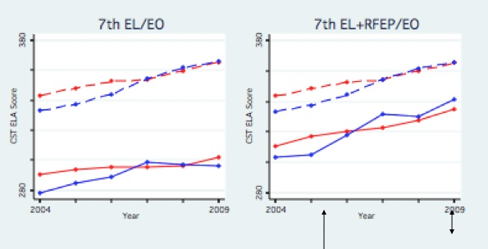
)
Hakuta & Thompson, 2009
Notes:
Kenji
Now, here is what you get if you exclude the former ELLs. The gap increases, and in fact, by 7th grade, the Sanger data shows that is is doing worse than the state as a whole. This is because Sanger is successful in reclassifying its ELLs, and therefore a larger proportion of their students are no longer in the ELL category. Rather than being rewarded for this, their data make them look worse than the state overall.
So, fixing this revolving door problem, while continuing to pay attention to the needs of the low-performing ELLs, is one focus of our recommendations.
Fixing the revolving door addresses concerns not just about the low-performing ELLs but also former ELLs:
For example, current law (regs) calls for subgroup accountability for graduation rates based on tracking cohorts of high school students and accounting for the outcome of each using individual student identifiers. A four year or extended year cohort measure will see too much turnover to reliably calculate graduation rates, but that problem is solved if schools are held accountable after proficiency is attained.
Also, concerns about inappropriate reclassification of ELLs before they become English proficient, are addressed by keeping all ELLs in the group.
Finally ...less important, but maybe worth mentioning is that problematic "n" size issues will be greatly diminished...so many schools and districts that serve fewer than 100 ELLS at a time would be held accountable for the more stable ELL group.

Slide 9
Master Plans
  formulates specific instructional approaches for a variety of English learners, e.g. newcomers and long term ELLs
  describes an assessment system that monitors ELLs for academic achievement and linguistic growth
  incorporates a systematic approach to developing teacher expertise in educating ELLs
  provides additional supports to ensure meaningful ELL access to the core curriculum

