Slide 1
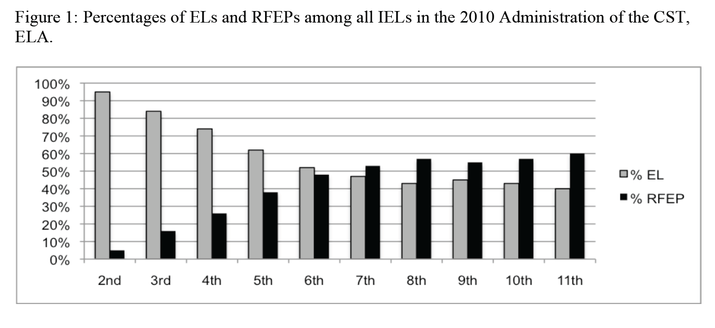
Saunders & Marcaletti

Slide 2
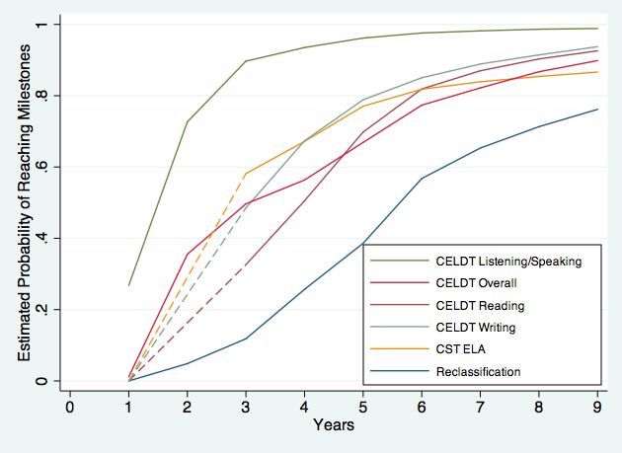
Thompson

Slide 3
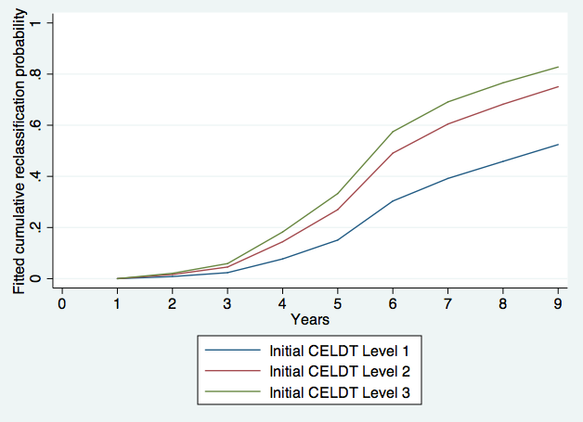
Thompson

Slide 4
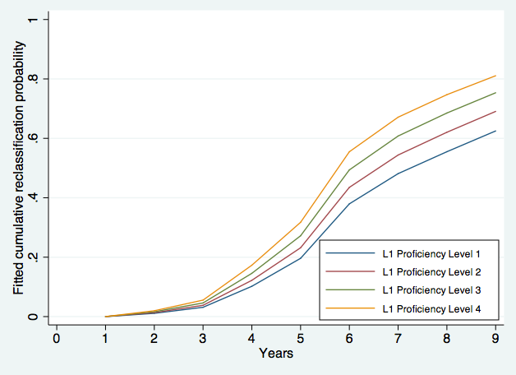
Thompson

Slide 5
Issues in the Development of AMAOs
Understanding second language acquisition should be a prerequisite to setting AMAO targets
  Set reasonable, but challenging language goals (not too high, not too low)
  Lower is faster; higher is slower
Federal Law provides guidance on how students are defined as limited English proficient. Student is an enrolled, school aged child:
  whose native language is not English, and
  whose difficulties in English deny them the ability to perform proficiently on the state’s achievement test, and
  whose difficulties in English deny them the ability to successfully participate in class where only English is spoken, and
  whose English language ability deny them the opportunity to participate fully in society

Slide 6
What are Districts facing… inadequate data and student information systems shortage of teachers prepared with the knowledge and skills to effectively teach Long Term English Learners lack of appropriate curriculum and materials targeted for this population contradictory mandates and counsel general misunderstandings and lack of knowledge of the research about effective practices for Long Term English Learners inadequate assessments and systems to know how English Learners are doing or to identify English Learners who are not adequately progressing widespread lack of understanding related to ELD and misunderstandings about what constitutes “English proficiency”
These are fundamentally, policy issues, but they are also leadership issues, which one has the greater role for change? There is a rising urge for a common set of tools → COMMON CORE
Olsen (2010)

Slide 7
Basic Principles for Supporting Long-Term ELs (Olsen 2010)
Urgency. Long-term ELs have a limited number of years left of schooling in which to overcome their academic and language proficiency gaps. Instruction needs to be accelerated, focused, and efficient.
Distinct Needs. Long-term ELs share characteristics with other groups but have their own unique set of needs. Moreover, a diversity of needs exists within the Long-term EL population.
Language and literacy development. Long-term ELs need instruction focused on literacy as well as language for multiple contexts and functions.
Support across the curriculum. Meeting Long-term ELs’ needs should be a shared responsibility throughout the school. Support for language development and academic success should be intertwined.
Primary language development. Home language support can help boost English literacy and language skills (e.g., through contrastive analysis and transfer).
Rigor. Long-term ELs need access to a challenging and relevant curriculum.
Relationships. Since Long-term ELs often have a history of being overlooked, it is important that teachers make personal connections with them.
Integration with access. Long-term ELs need to be integrated with other students and in all school activities but with supports to ensure success in those settings.

Slide 8
Week 6: Long Term English Language Learners
Double the Work is a report that presents some of the challenges and solutions related to long term ELLs. The focus of the report is to address academic literacy which is seen as a key to academic success. The panel presents their findings as well as six recommendations for policymakers to help these students.
Recommendations for policymakers include:
1. Tightening the criteria and definition of LEP and reclassification to assure uniform use across states.
2. Develop improved assessments to evaluate adolescent's native language, ELD, AND content learning.
3. Create policy which ensures all teachers of ELLs learn about second language and literacy acquisition, reading across content areas, sheltered immersion, and ESL methods.
4. Adjust NCLB accountability to avoid penalizing schools for ELL students taking longer than the traditional 4 years to complete high school.
5. Encourage the use and promotion of proven and promising methods with ELLs.
6. Fund and conduct more short and long term research on new and existing intervention programs and academic performance for long term ELLs.
Reference: Short, Deborah J.; Fitzsimmons, Shannon, Double the Work: Challenges and Solutions to Acquiring Language and Academic Literacy for Adolescent English Language Learner. New York: Carnegie Corporation of New York.

Slide 9
Flexible Pathways to Graduation for Long Term ELL: Strategies to Consider
Requiring that program design decisions be based on appropriate and effective language development practices, as determined by rigorous surveys of student data.
Adjusting or developing sheltered curriculum frameworks for high school content courses and establishing core credit for these courses.
Allowing schools greater flexibility in the use of learning time and encouraging them to provide ELLs with extended or extra opportunities for literacy instruction beyond the classroom (and coordinate with any out-of-school tutoring or mentoring opportunities).
Encouraging the development of plans for a 5-year high school path for beginning level ELLs who enter in ninth grade that include rigorous preparation for students with either college or vocational goals.
Adjusting school accountability measures under NCLB to avoid penalizing districts and schools that allow ELL students to take more than the traditional 4 years to complete high school successfully.
Securing appropriate funding for these endeavors.
-How are current graduation policies and strategies not meeting the needs of long term ELLs?
-What are are different ways in which we can envision graduation requirements for long term ELLs, specifically recent immigrant students?
-What are the best ways in which we can prepare long term ELLs for life after graduation?

Slide 10
Promoting Academic Achievement Among English Learners
There has been a time when “one size fits all” policy was applied to the long-term English language learners, but there are distinct language issues as well as shared characteristics.
One of the lessons learned from this reading is that if these characteristics are not recognized, the students may not nurture or cultivate the kind of learning/studying behavior and attitude necessary to overcome the “intermediate” level where they could easily be stuck.
One suggestion in the reading is to not only focus on literacy development but also to focus on development of speaking, listening, reading and writing skills. Perhaps this is another way of saying teaching English language contextually.

Slide 11
Seven Things Every District Leader Should do to Support LTELs
_______________________
_______________________
_______________________
_______________________
_______________________
_______________________
_______________________

